Slide 1










Please do not rely on your child to relay any transportation changes to me. Please call the office before 2:00 if there are changes to the normal schedule. Thank you!
I believe that the parent-child-teacher connection is integral to success in school. I am here to support you and your child and will always be their advocate. I hope you let me know if you have any concerns about home or school life. Your child’s happiness and overall well
being are priorities to me
during their time in
Kindergarten. I want them
to feel safe and loved within
the walls of our room and in
our entire school!
The best way to contact me is through email or Class Dojo messages.
I check each child’s folder daily so feel free to write a note to me there as well. Please also check your child’s folder each evening in case I write a quick note to you!
At Thorpe Gordon Elementary our building expectations are that each student is Safe, Respectful, and Responsible each and every day. I use Class Dojo to reinforce these rules. Class Dojo is an app you can download to your phone. I will be sending home a code specific to your child in the first few days of school. You will be able to see how your child’s day went by logging into the app.
2020
Mrs. Distler
Kindergarten
Room C
E-mail:
michelle.distler@jcschools.us
Phone: 573-659-3170
:

Slide 2
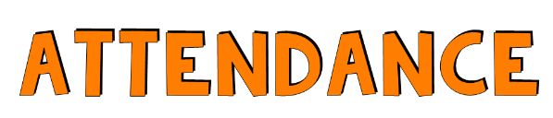
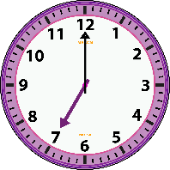




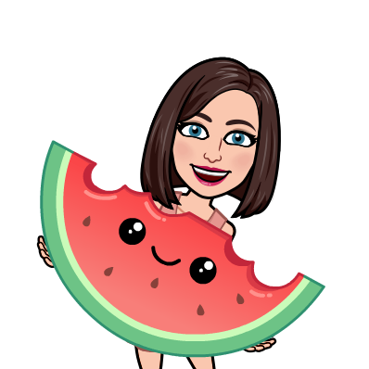



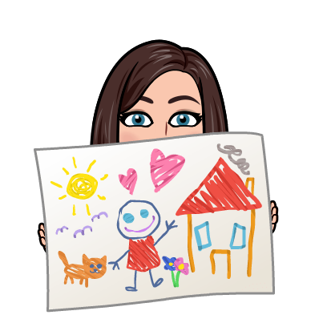

Your child’s regular and prompt attendance at school is very important to his or her success. Please view school as a priority and see that your child attends school every day except in cases of illness or emergency. Students can arrive to school as early as 7:15 and school hours are 7:45-2:45.
There will be a monthly homework packet sent home at the beginning of each month.. Each Friday I will check homework and if it has been completed I will give a special treat! No pressure with the homework packet--it will not be taken for any kind of grade.
Monday-Friday
7:15-7:45-- Breakfast in the Classroom
7:45-8:10--Morning Meeting
8:10-8:45--ELA/Word Work
8:45-9:10--Recess
9:15-10:40--Writing
10:40-11:25--Lunch/ Recess
11:30-12:35--Literacy Corners
12:40-1:25--Art/Music/PE
1:30-1:45--Snack
1:50-2:30--Science/Social Studies
2:30-2:45--Clean up and Pack up
2:45--Dismissal
*There is a possibility that this could change several times throughout the year!
Please send a healthy snack for your child to eat each day!
Art and Music will be in our classroom this year, and PE will be outside when possible.
I know your child’s birthday is a special day! If you decide to send in birthday treats for your child’s birthday they must be store bought.

